Slide 1


Slide 2
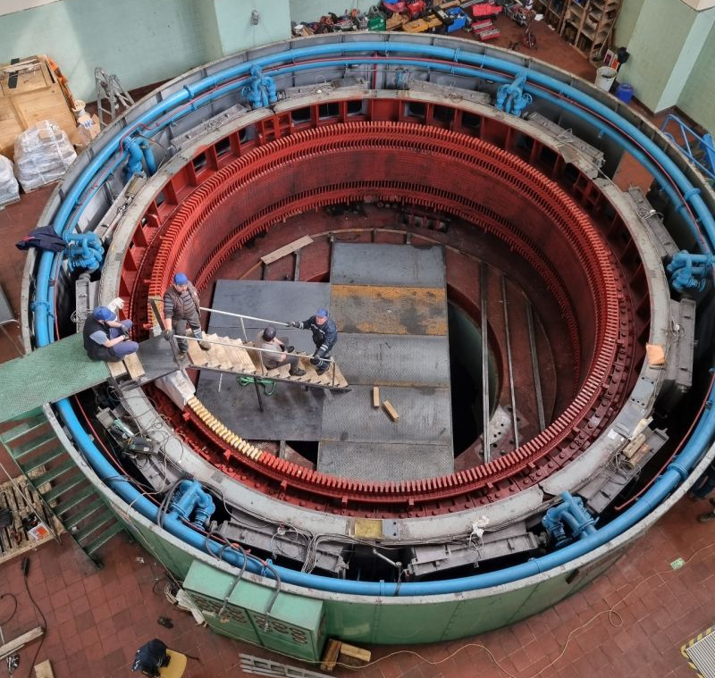
Vibrational Forces in Hydro Generators
M. Samet Yakut
11.03.2024

Slide 3
Outline
Background Information
Cogging Torque
Airgap Magnetic Field
Force Density
Comparison
Future Plans

Slide 4
Background Information
Main Sources:
Slot harmonics
Cogging torque
Sub-harmonics
Slot harmonics and cogging torque are higher frequency harmonics
Those are more important in wind turbines

Slide 5
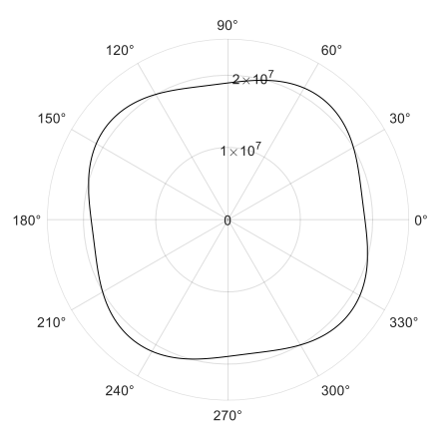
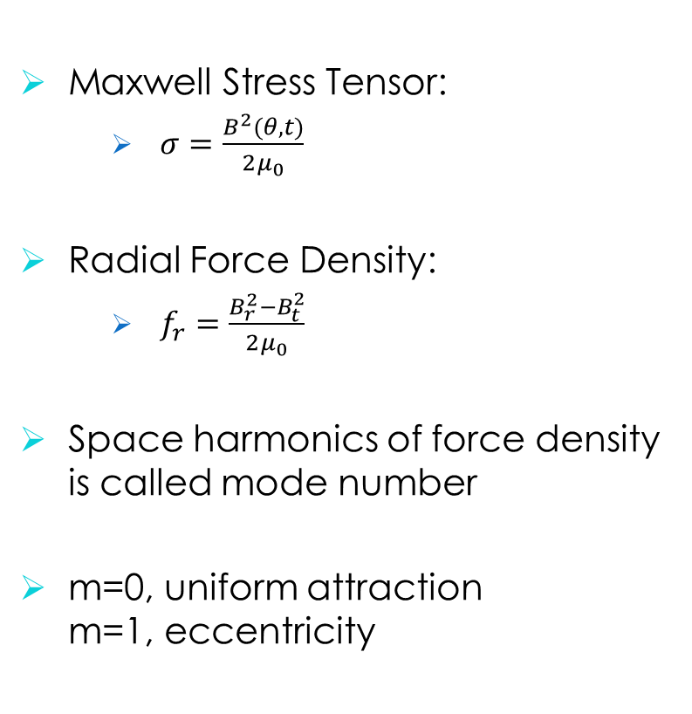
Background Information
Maxwell Stress Tensor:
$σ=\frac{B^{2}(θ,t)}{2μ_{0}}$
Radial Force Density:
$f_{r}=\frac{B_{r}^{2}−B_{t}^{2}}{2μ_{0}}$
Space harmonics of force density is called mode number
m=0, uniform attraction m=1, eccentricity

Slide 6
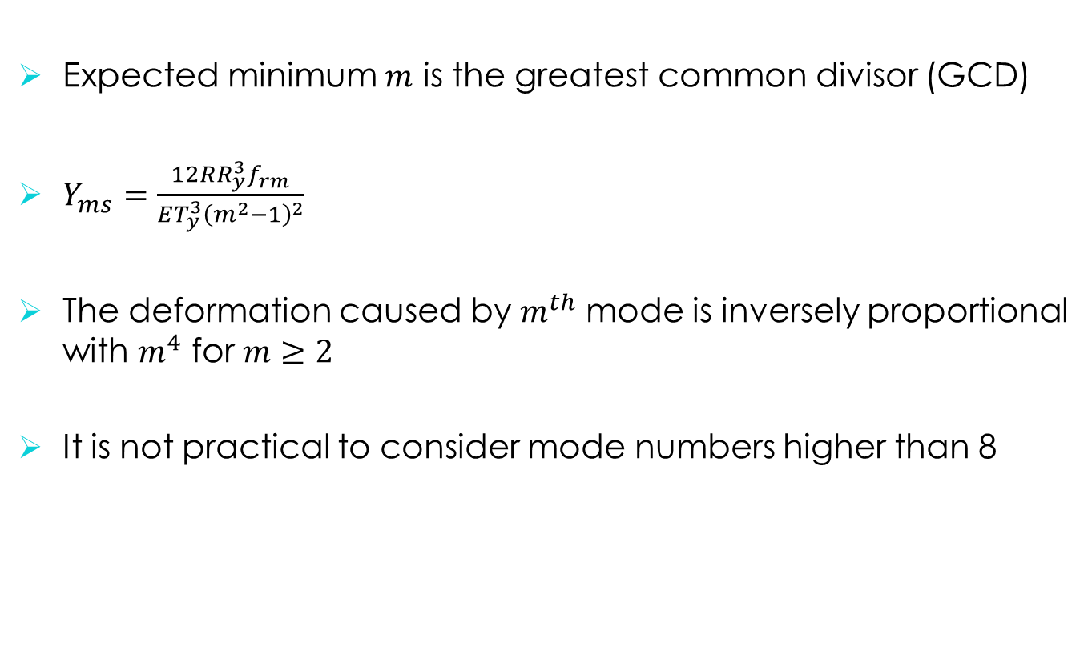
Background Information
Expected minimum $m$ is the greatest common divisor (GCD)
$Y_{ms}=\frac{12RR_{y}^{3}f_{rm}}{ET_{y}^{3}{\left(m^{2}−1\right)}^{2}}$
The deformation caused by $m^{th}$ mode is inversely proportional with $m^{4}$ for $m≥2$
It is not practical to consider mode numbers higher than 8

Slide 7
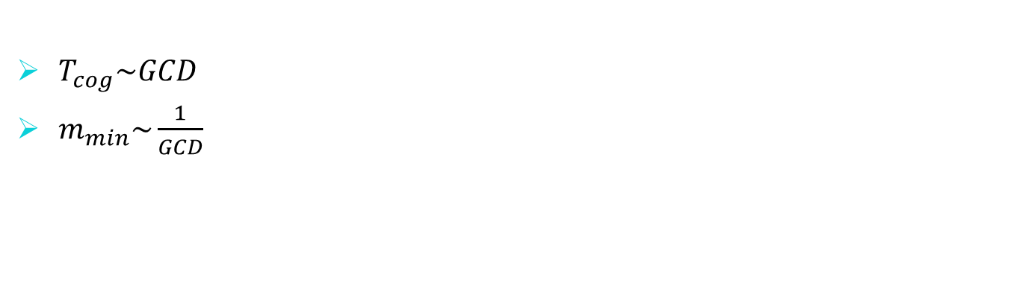
Machines under Concern
$T_{cog}\sim GCD$
$m_{min}\sim \frac{1}{GCD}$
Slot Number | Pole Number | Winding Type | Series/Parallel Turns | Symmetry
240 | 32 | Diamond | 5/4 | 16
270 | 32 | Roebel | 1/1 | 2
300 | 32 | Roebel | 1/1 | 4
324 | 32 | Roebel | 1/1 | 4

Slide 8
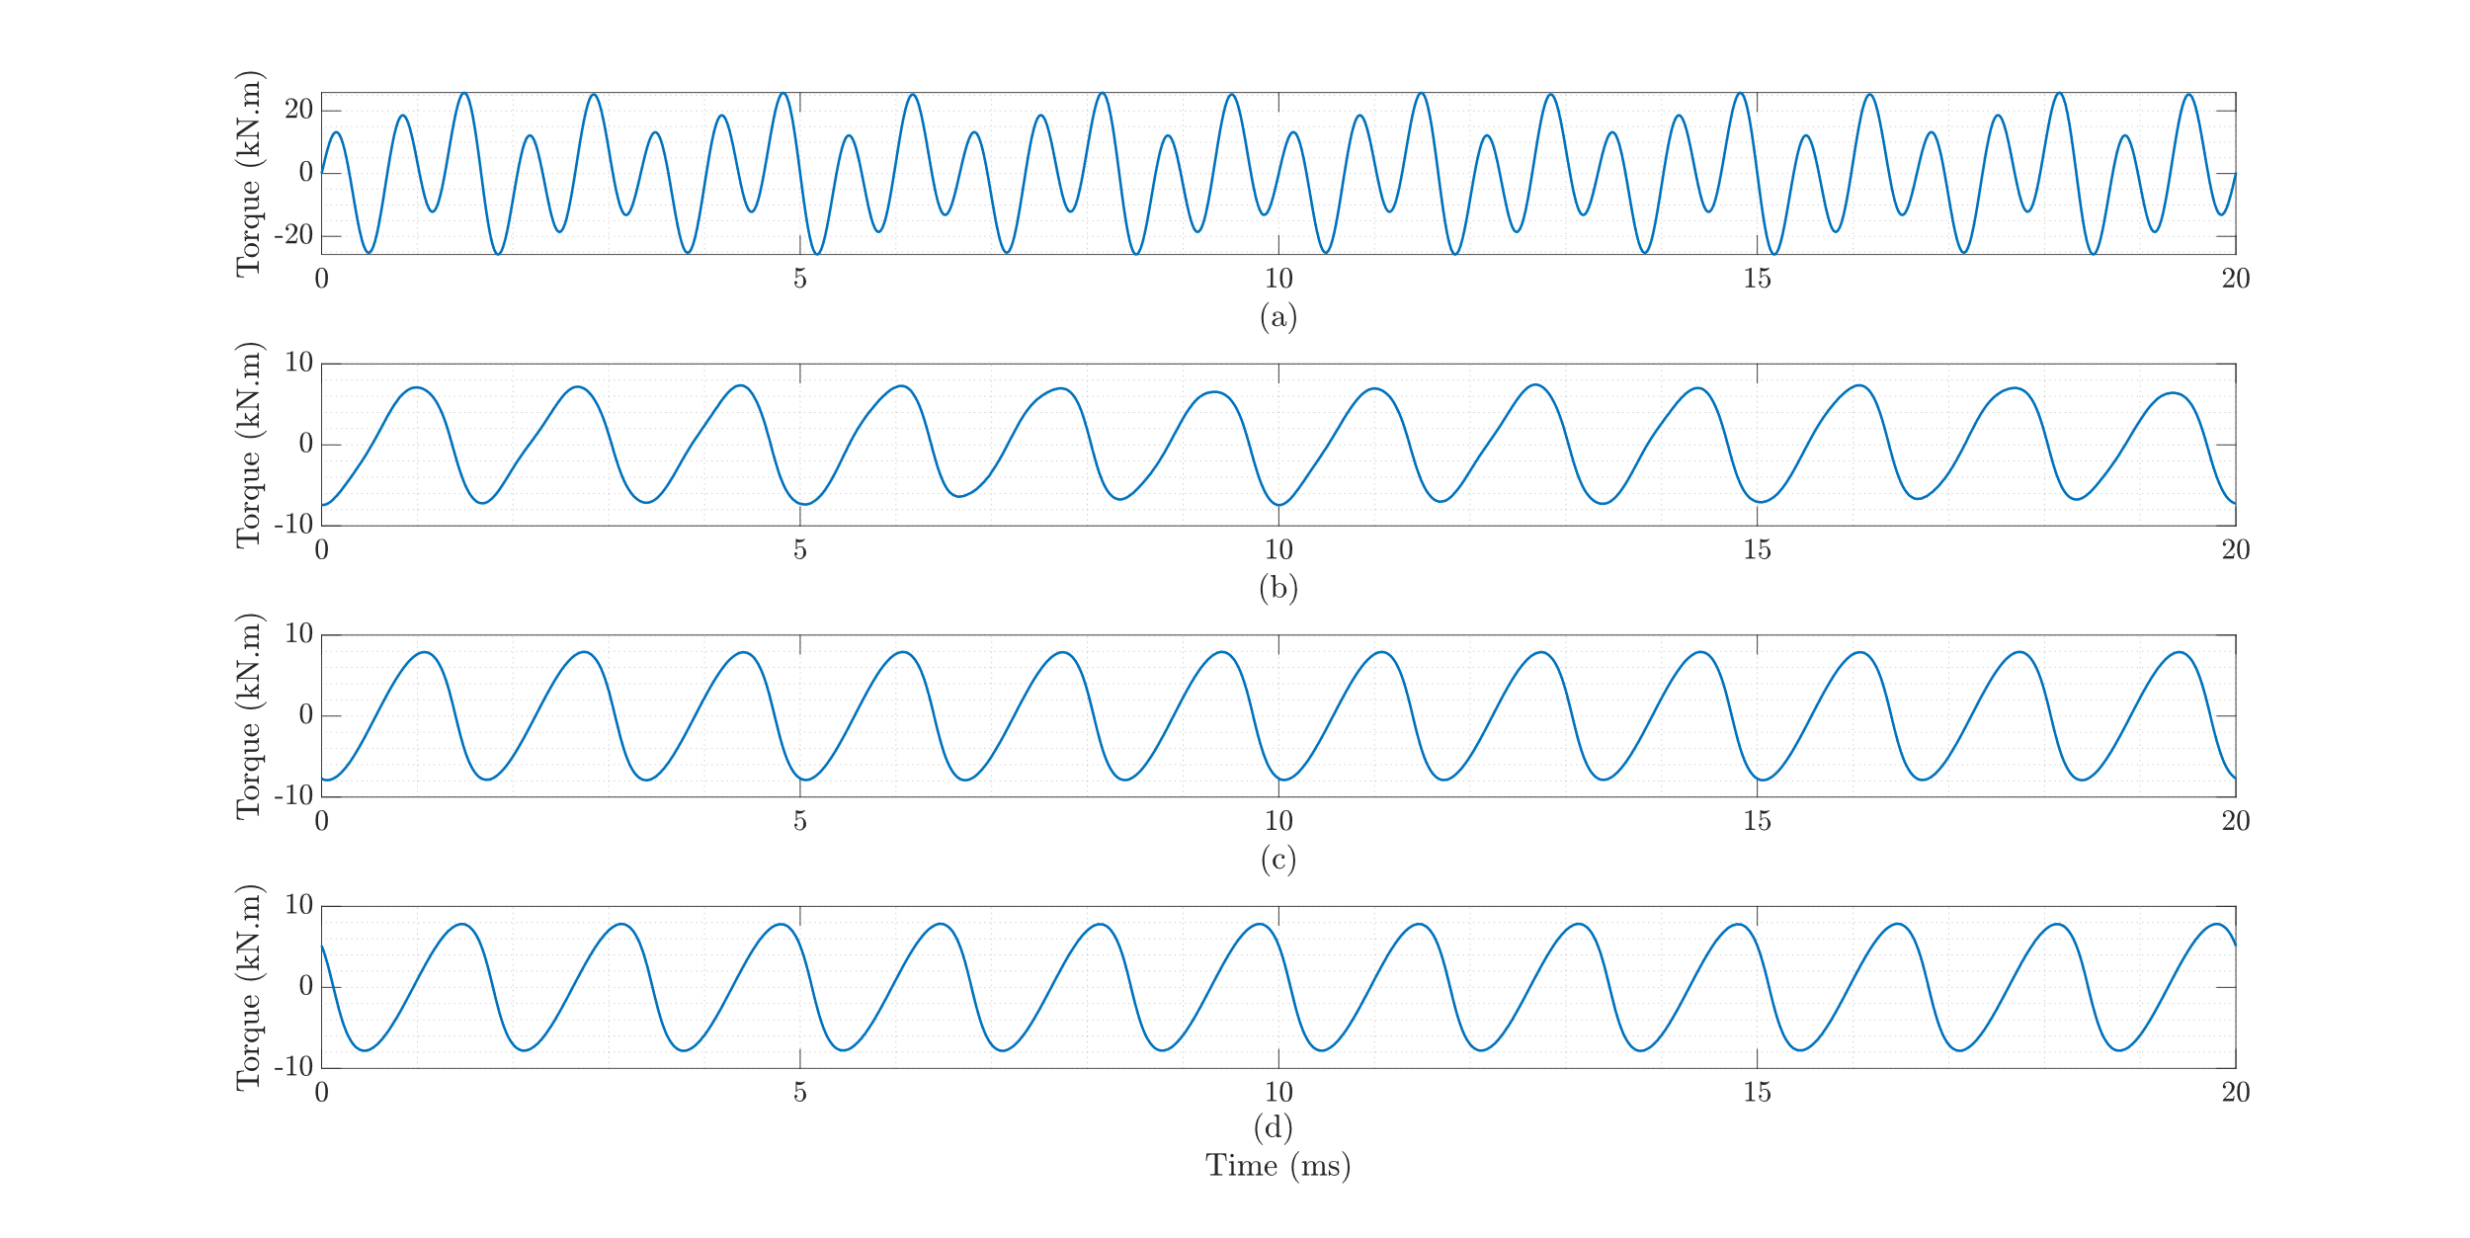
Cogging Torque
Open-circuit Torque
(a) 240 Slot, (b) 270 Slot, (c) 300 Slot, and (d) 324 Slot

Slide 9
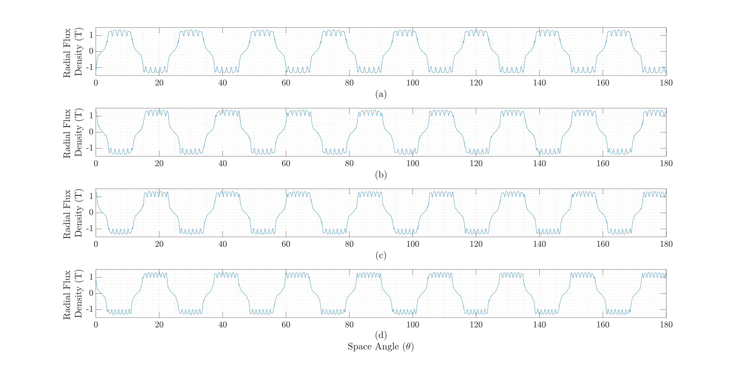
Airgap Magnetic Field
No Load
(a) 240 Slot, (b) 270 Slot, (c) 300 Slot, and (d) 324 Slot

Slide 10
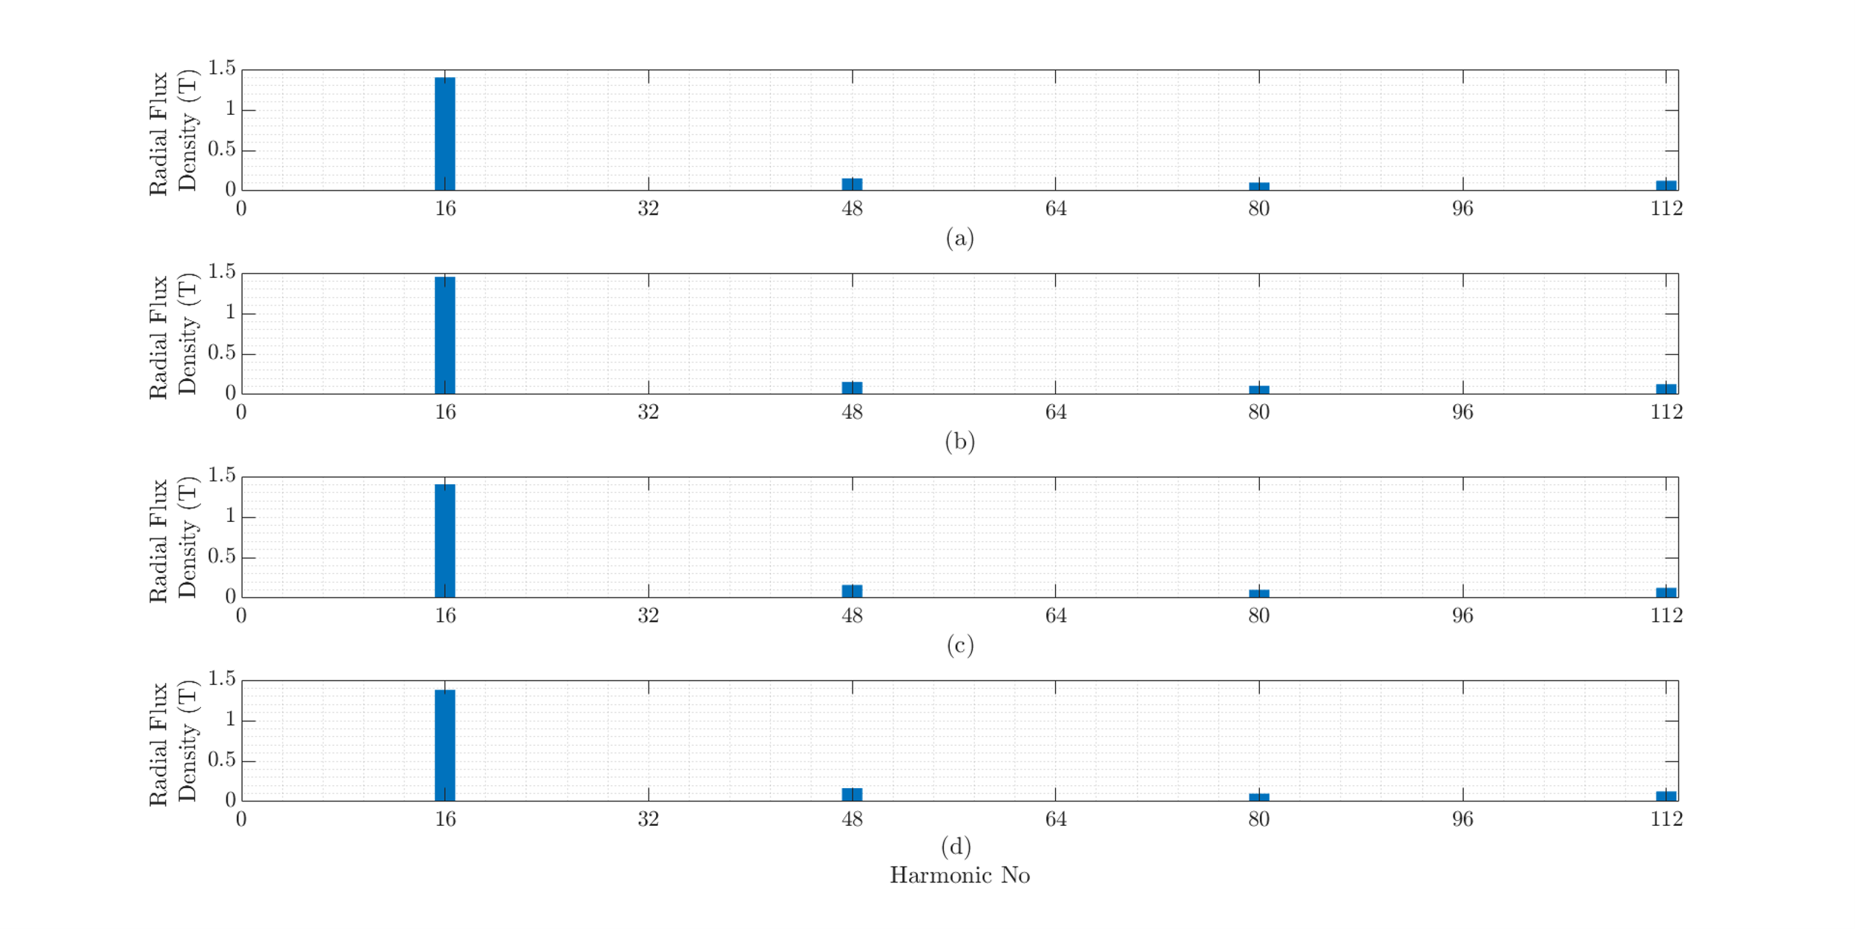
Airgap Magnetic Field
No Load
(a) 240 Slot, (b) 270 Slot, (c) 300 Slot, and (d) 324 Slot

Slide 11
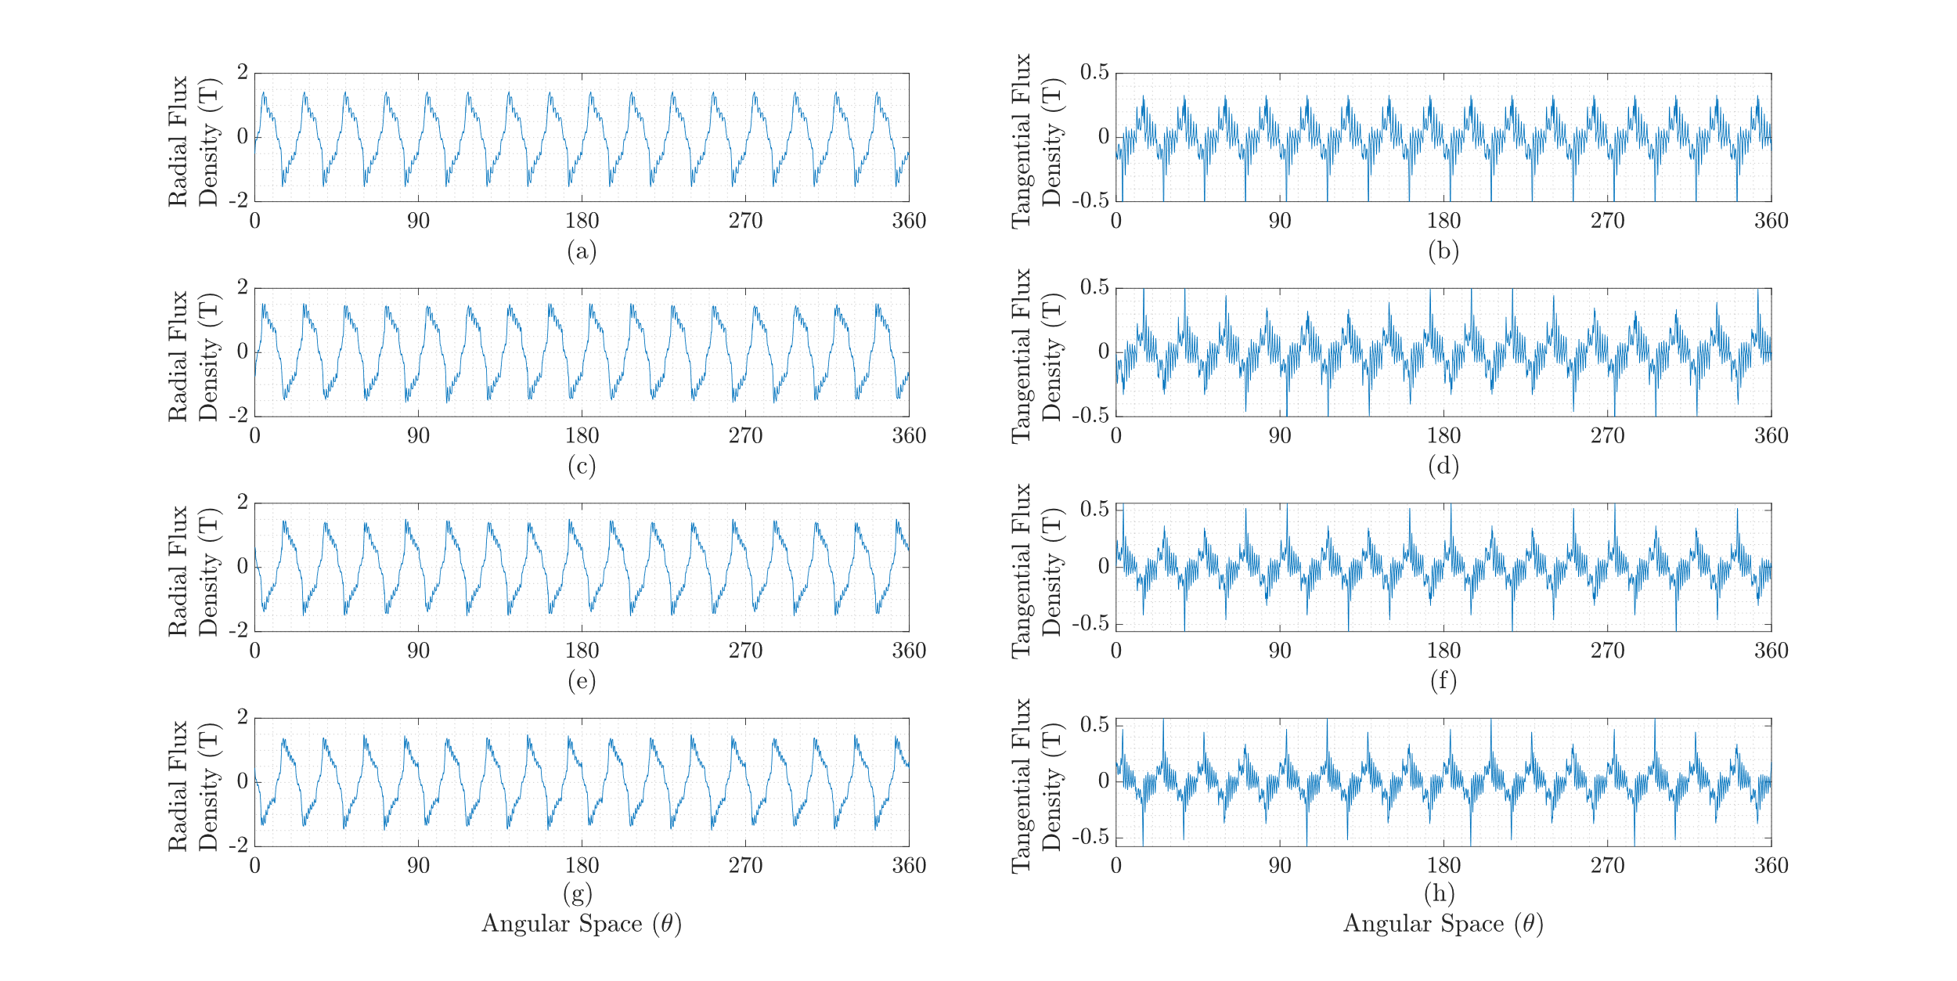
Airgap Magnetic Field
Inductive Load
(a),(b) 240 Slot; (c),(d) 270 Slot; (e),(f) 300 Slot; and (g),(h) 324 Slot

Slide 12
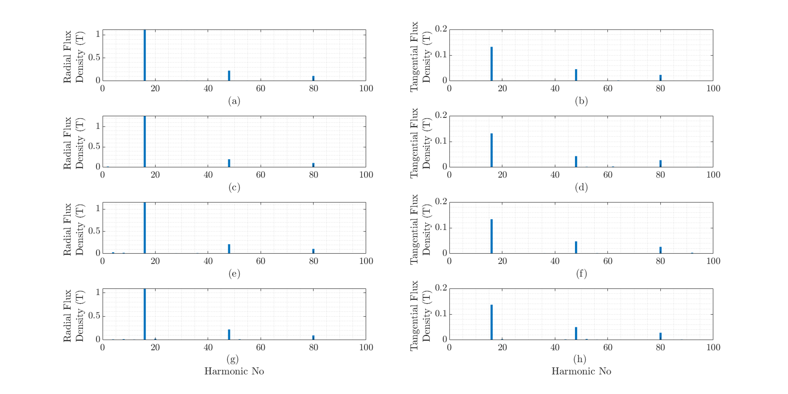
Airgap Magnetic Field
FFT of inductive load case
(a),(b) 240 Slot; (c),(d) 270 Slot; (e),(f) 300 Slot; and (g),(h) 324 Slot

Slide 13
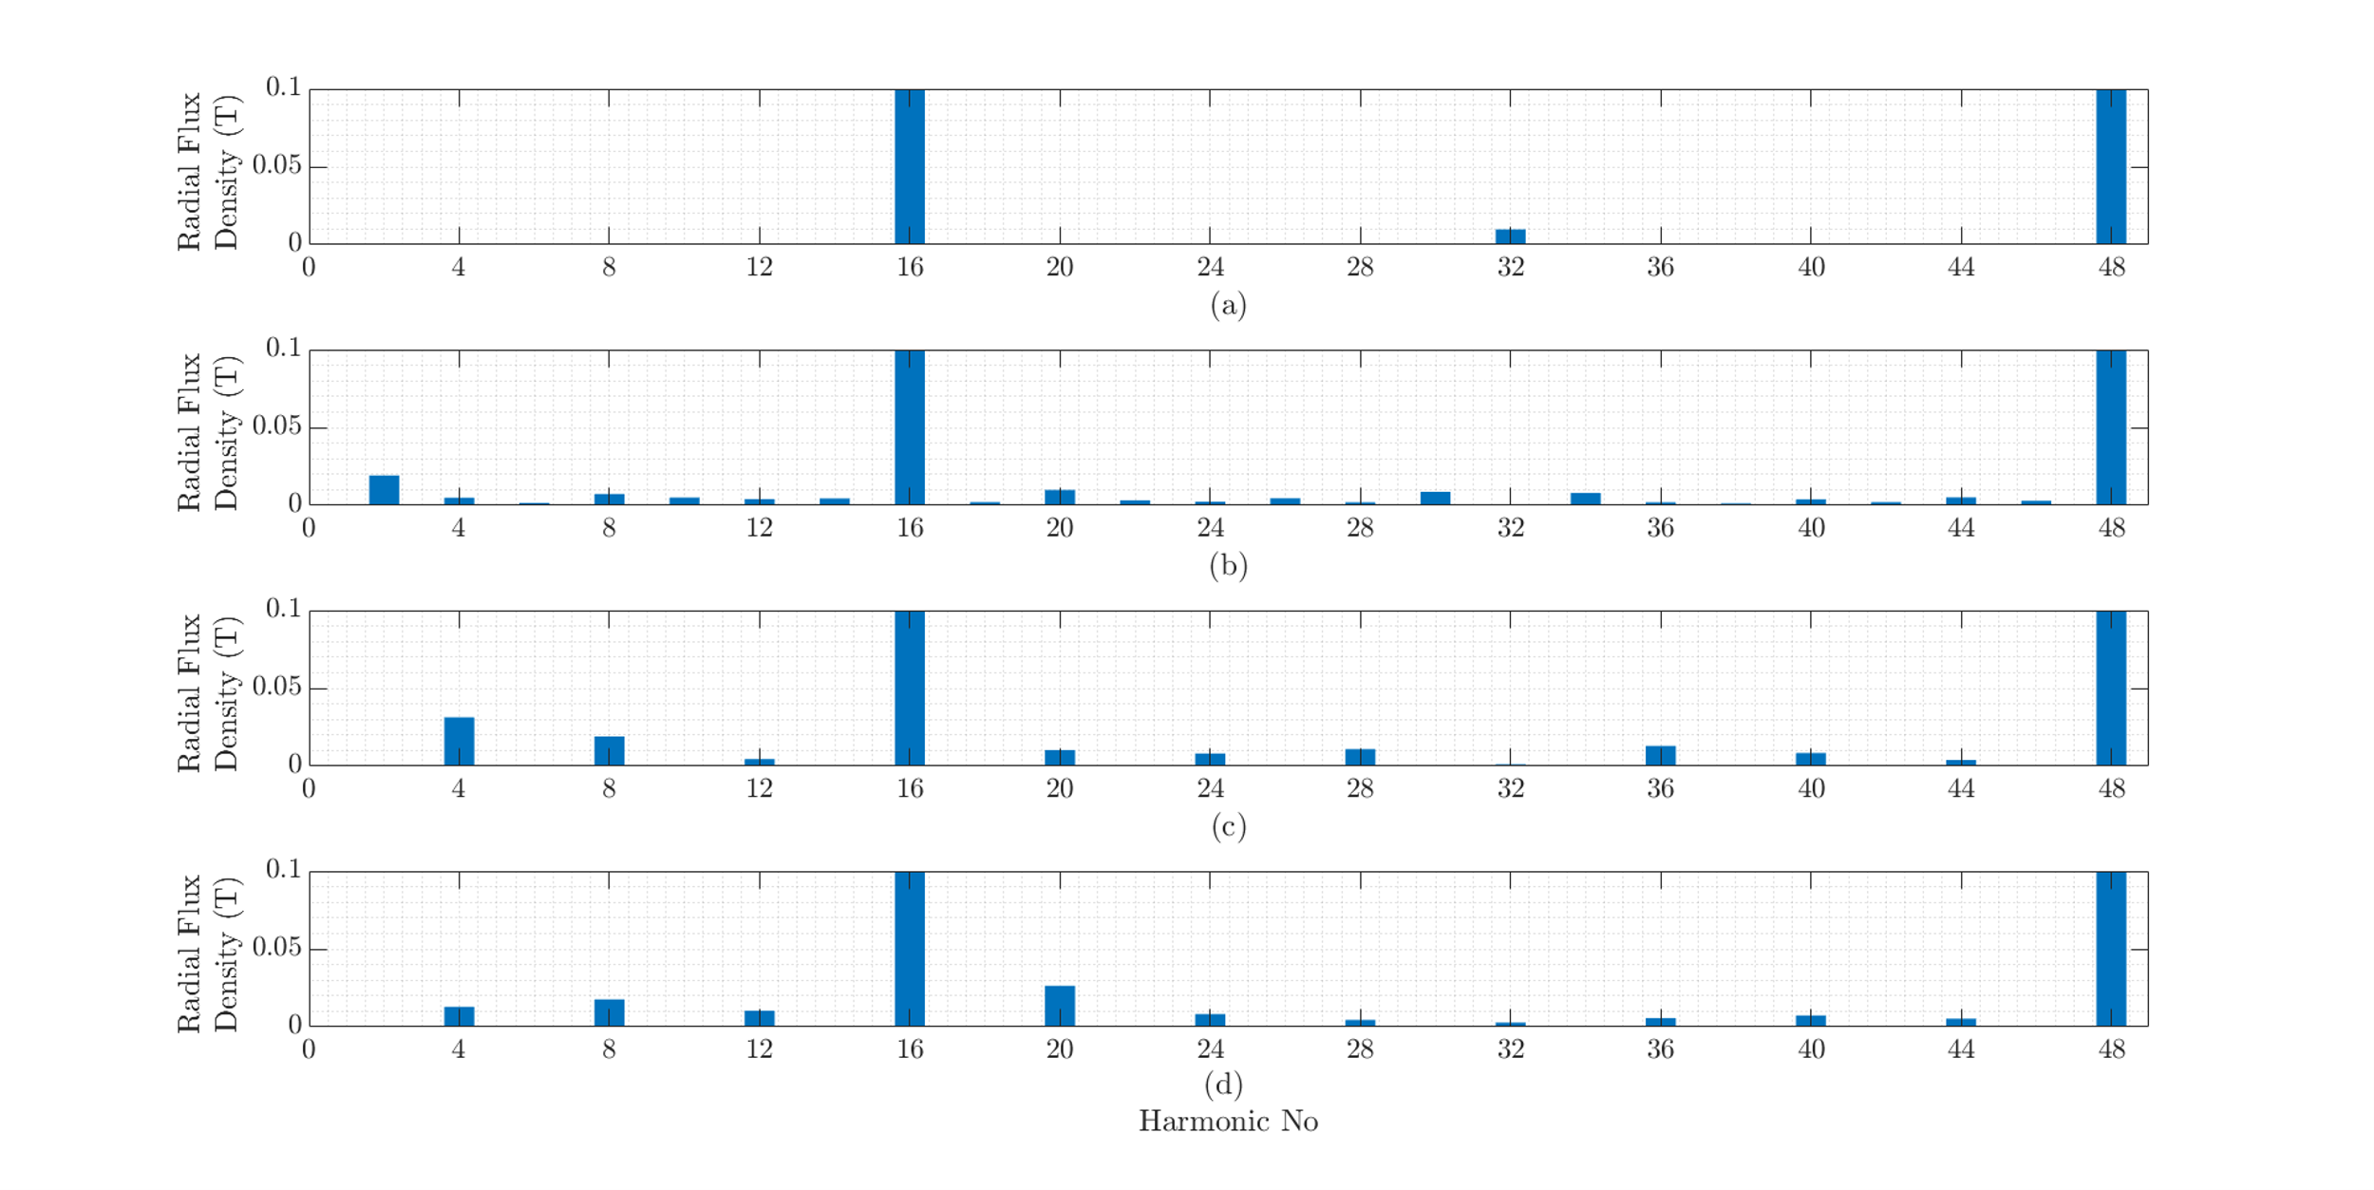
Airgap Magnetic Field
FFT of inductive load case
(a),(b) 240 Slot; (c),(d) 270 Slot; (e),(f) 300 Slot; and (g),(h) 324 Slot

Slide 14
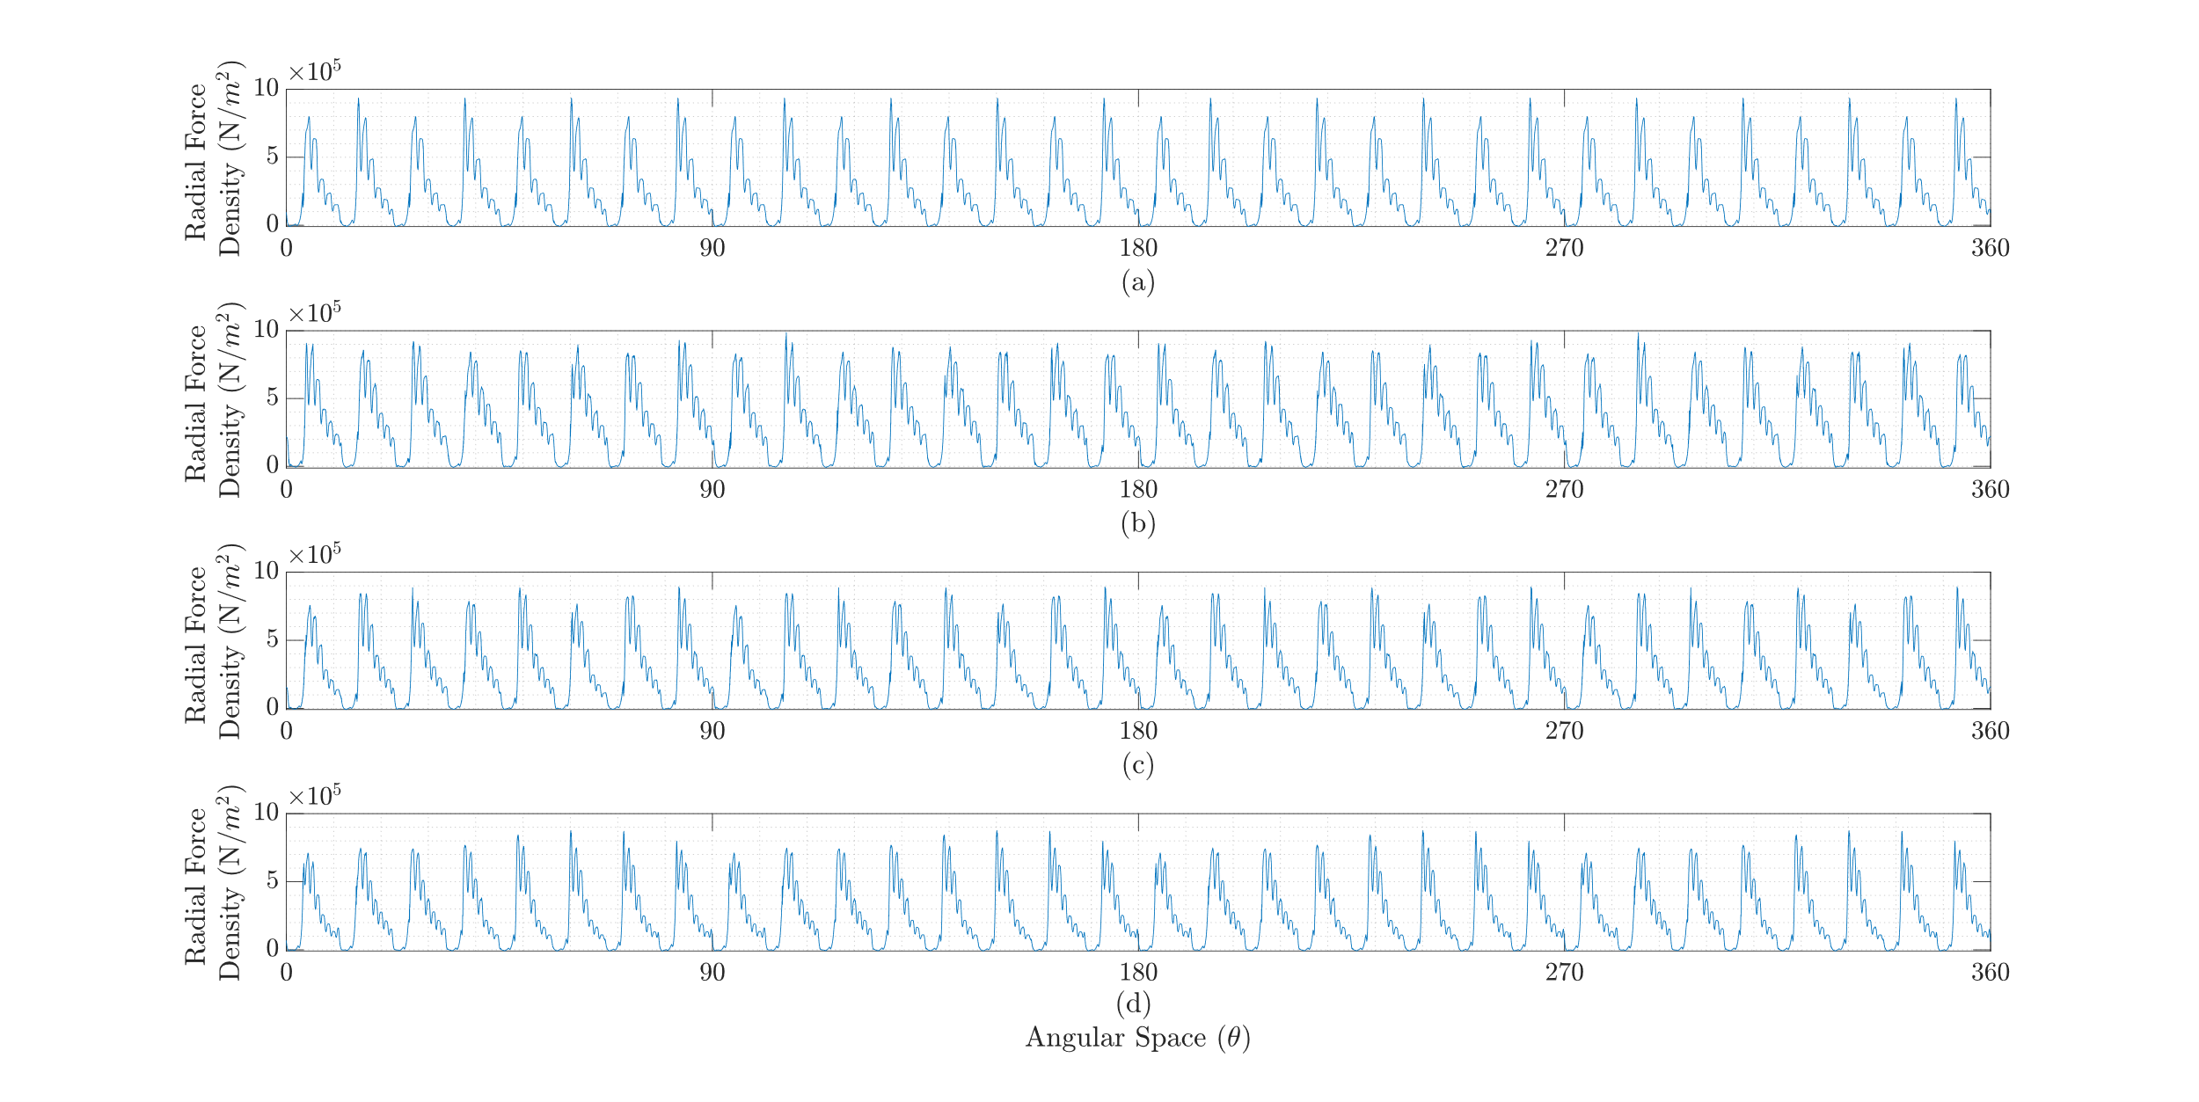
Radial Force Density
(a) 240 Slot, (b) 270 Slot, (c) 300 Slot, and (d) 324 Slot

Slide 15
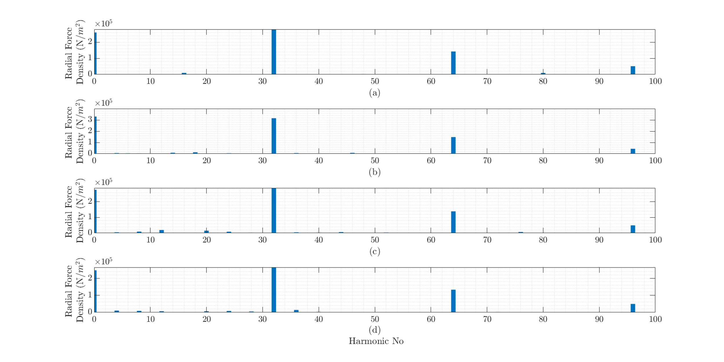
Radial Force Density
(a) 240 Slot, (b) 270 Slot, (c) 300 Slot, and (d) 324 Slot

Slide 16
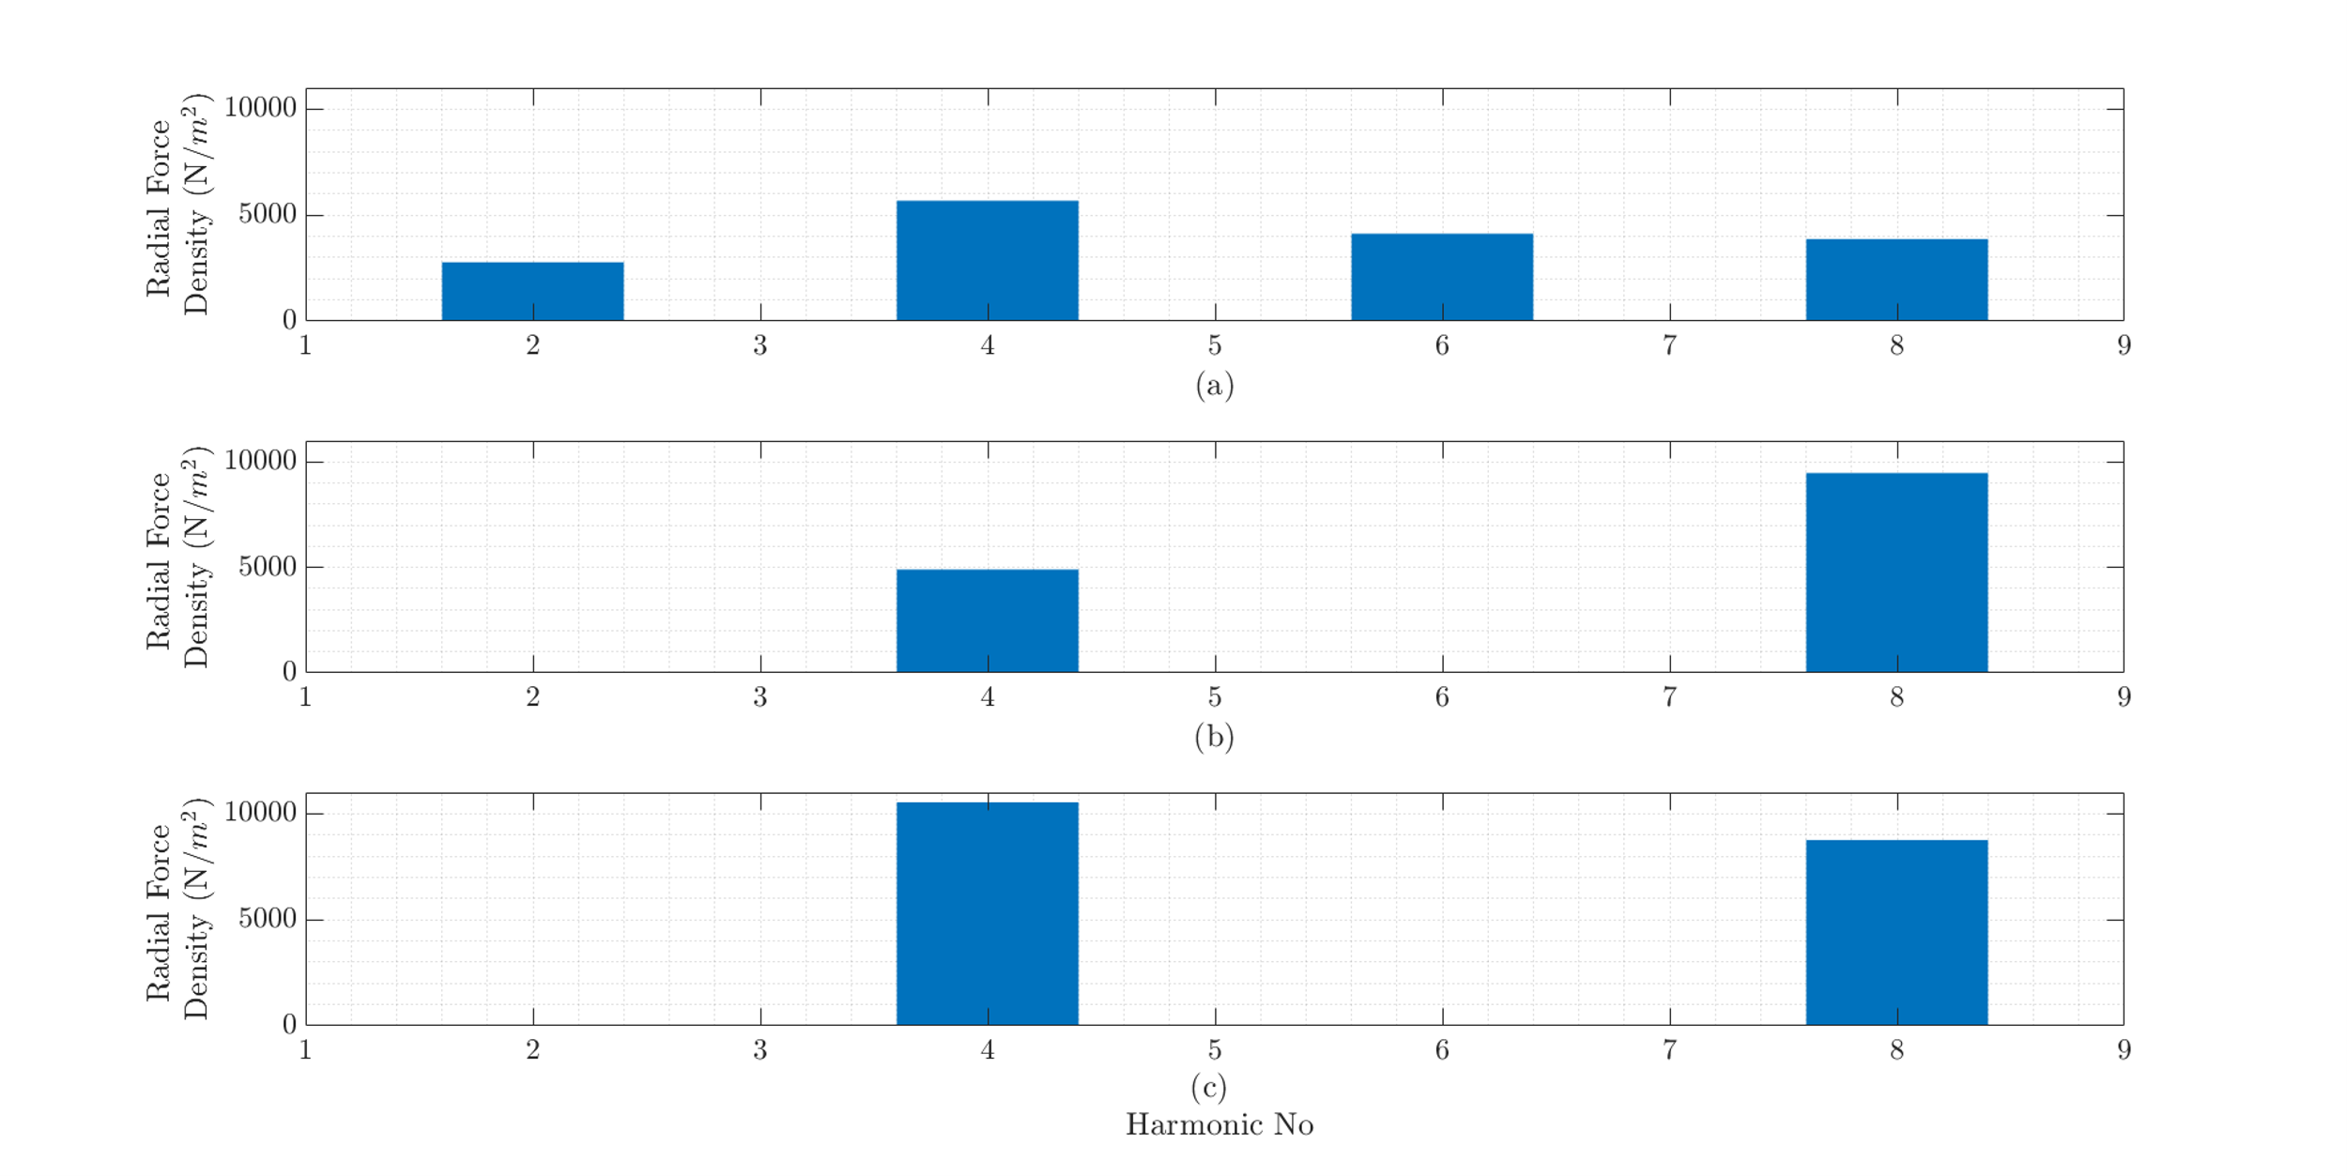
Radial Force Density
(a) 270 Slot, (b) 300 Slot, and (c) 324 Slot

Slide 17
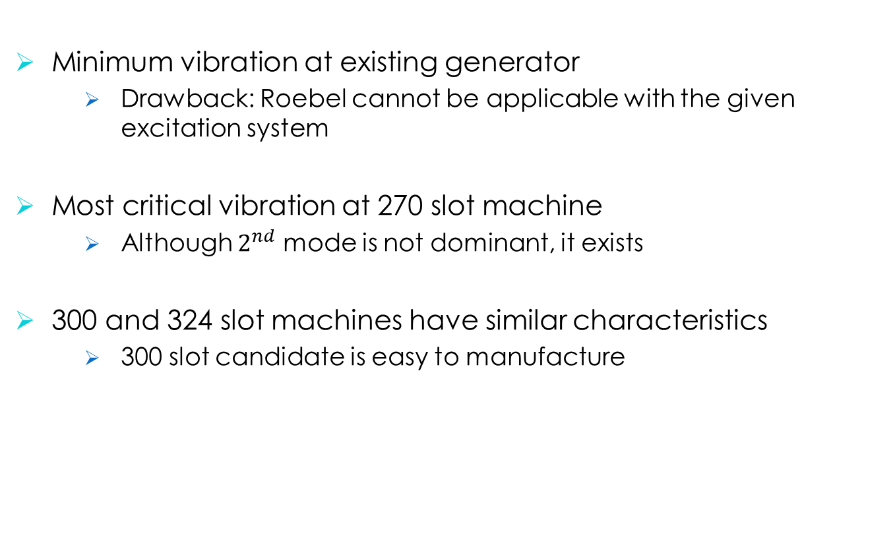
Comparison
Minimum vibration at existing generator
Drawback: Roebel cannot be applicable with the given excitation system
Most critical vibration at 270 slot machine
Although $2^{nd}$ mode is not dominant, it exists
300 and 324 slot machines have similar characteristics
300 slot candidate is easy to manufacture

Slide 18
Future Plans
Marriage :)
Prototype Roebel bar tests
Finalizing the production documents
Thesis work

